Slide 1
TASK MANAGEMENT APP
Building a Task Management App to Create, Update, and Delete Tasks using React, HTML, JavaScript, and CSS

Slide 2
INTRODUCTION
Task management apps help users keep track of tasks, organize them, and manage productivity.
This project involves developing a basic Task Management Application using React, HTML, JavaScript, and CSS, enabling users to create, update, and delete tasks seamlessly.
The application aims to provide a user-friendly interface for managing personal or work-related tasks by implementing the essential CRUD (Create, Read, Update, Delete) operations.

Slide 3
FEATURES
Task creation, editing, and deletion
Filtering and sorting tasks by priority or due date
Notifications or reminders

Slide 4
PURPOSE
Build a simplified task management app using React, HTML, CSS, and JavaScript.
Implement CRUD (Create, Read, Update, Delete) functionalities for tasks.

Slide 5
TOOLS & TECHNOLOGIES
React: A JavaScript library for building user interfaces, especially suitable for single-page applications.
HTML: Used for structuring the app's content.
CSS: Styling and layout to create an engaging user interface.
JavaScript: The programming language to implement logic and functionality.
Optional: JSON-Server for local backend or any mock API service if needed.

Slide 6
PROJECT STRUCTURE
Project Setup:
Initialize a new React project using npx create-react-app task-manager.
Folder Structure:
src/components: Contains individual components (e.g., Task, TaskList, TaskForm).
src/styles: CSS files for styling components.
src/App.js: The main app component where routing and layout are configured.
src/index.js: The entry point of the app.

Slide 7
BASIC LAYOUT & STYLING
Header: Contains the app's title and any navigation links.
Task List: Displays all tasks in a list.
Task Form: A form to create and update tasks (with input fields for title and description).
CSS Styling:
Basic styling for layout and color scheme.
Mobile responsiveness for different screen sizes.

Slide 8
CREATING COMPONENTS
Task Component: Represents a single task with title, description, and action buttons (edit and delete).
Task List Component: Manages the list of tasks, mapping each to a Task component.
Task Form Component: A form to add or edit tasks.
App Component: Holds the overall state of the application (tasks array) and manages component interactions.

Slide 9
IMPLEMENTING STATE WITH USESTATE HOOK
Why use useState?:
UseState provides stateful logic within functional components.
Task State:
An array of task objects with properties: id, title, description.
Managing Form Data:
Separate states for title and description of the task.

Slide 10
CREATING TASKS
Functionality:
Implement an addTask function in the App component.
Create a unique ID (e.g., using Date.now()).
Add the new task to the tasks array.

Slide 11
READING & DISPLAYING TASKS
Mapping Tasks:
Use the map function to render each task within the TaskList component.
Pass task data as props to the Task component.

Slide 12
UPDATING TASKS
Edit Mode:
Add an editTask function that updates a task's title and description.
Update TaskForm to support editing by setting the input fields with the task’s current data.

Slide 13
DELETING TASKS
Delete Functionality: Implement a deleteTask function that removes a task by filtering out the task with the selected ID.
Add a Delete Button: Ensure that each task item in the list has a delete button.
Pass the Delete Function: Pass the delete function as a prop to the Task component.
Handle Delete: In the main App component, implement the delete function to update the state by removing the selected task.

Slide 14
ADDING SOME EXTRA FEATURES
Filter or Sort Tasks: Add buttons or dropdowns to filter or sort tasks.
Mark Task as Complete: Add a checkbox or button to mark a task as complete.
Save to Local Storage: Use localStorage to save tasks persistently across page reloads

Slide 15
CODE WALKTHROUGH
Show Code Demo:
Walk through each component’s code.
Explain how App.js coordinates state and props between components.
Demo CRUD Operations:
Show how to create, read, update, and delete tasks.

Slide 16
TESTING & DEBUGGING
Testing User Flows: Test that users can add, edit, delete tasks successfully.
Debugging:
Use browser developer tools for inspecting elements, debugging JavaScript, and tracking state changes.
Common Issues:
Ensure IDs are unique, and state updates are correct.
Check if all components receive necessary props.

Slide 17
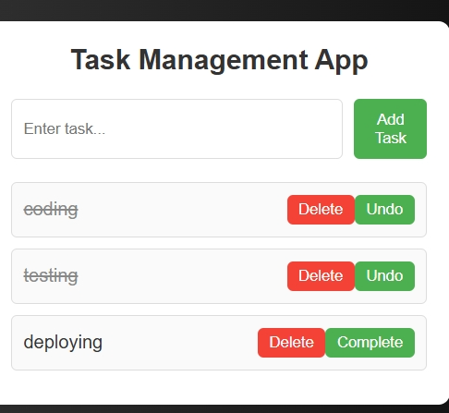
Output

Slide 18
CONCLUSION AND Q&A
Key Takeaways:
Building a task management app with React involves component-based design and state management.
CRUD operations are achievable with React’s state and hooks.
Future Enhancements:
Adding backend integration for user authentication.
Adding due dates, priorities, and reminders.
Questions?

Slide 19
THANK YOU

